Slide 1
POP PROJECT
TOPIC:-
SIMPLE QUIZ SYSTEM
GROUP MEMBER’S:-
VENKATESH B.H
RASHAD AHMED
NITEESH KUMAR
VISHAL NIRNE

Slide 2

JAVA
JAVA IS A :
Simple
Object-oriented
Interpreted
Secure
Portable
Platform Independent

Slide 3
OBJECTIVES
This concept of online test fulfils the following requirements:
It provides a less expensive as well as an effective method of performing examinations.
It provides best facilities for the students to answer the question only with a single click.
It saves time as well as money.
It lessens the student’s and teacher’s frustration.

Slide 4
TOP LEVEL DFD
(Data Flow Diagram)
MARKS GENERATED
QUIZ TEST
CANDIDATE
PERCENTAGE
RESULT

Slide 5
ENTITY-RELATIONSHIP DIAGRAM
GIVES
CANDIDATE
ONLINE TEST
QUESTIONS
%AGE
NAME
INSTRUCTIONS
MARKS

Slide 6
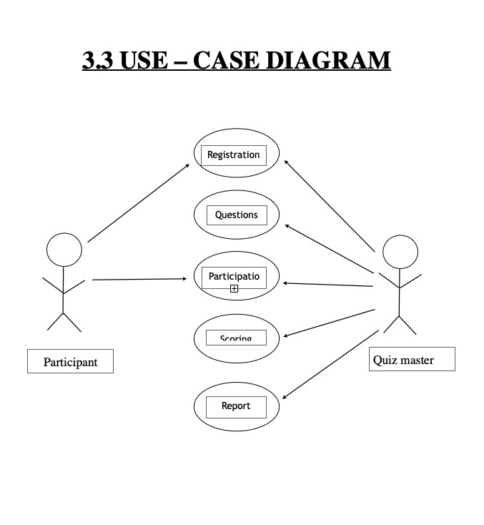

Slide 7
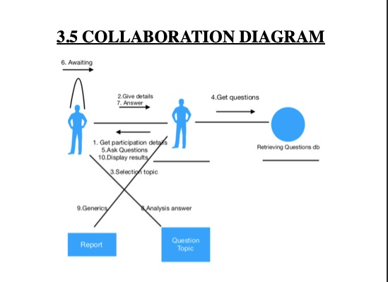

Slide 8
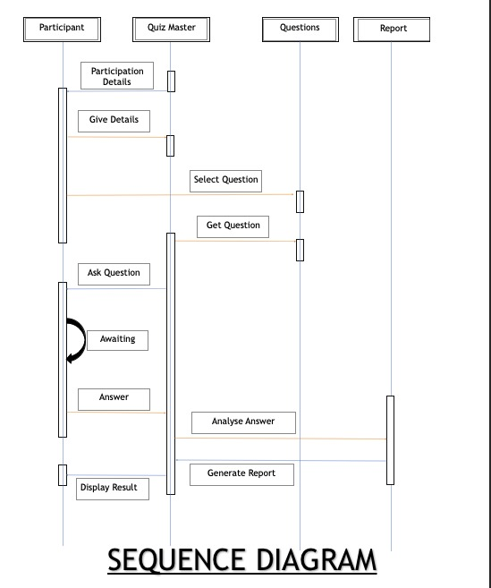

Slide 9
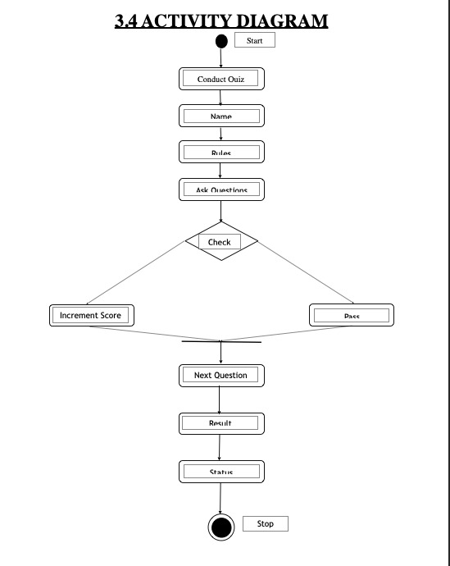

Slide 10
Start
Enter user name
FLOW
CHART
No
Proceed
Press
cancel
Yes
Press OK
Window displayed
Click Start to
Run the test
Questions answered in given time?
NO
Timer
over
Ye
Click Finish to
Check result
End

Slide 11



WORKING
OF
PROJECT

Slide 12
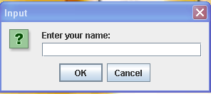

Slide 13
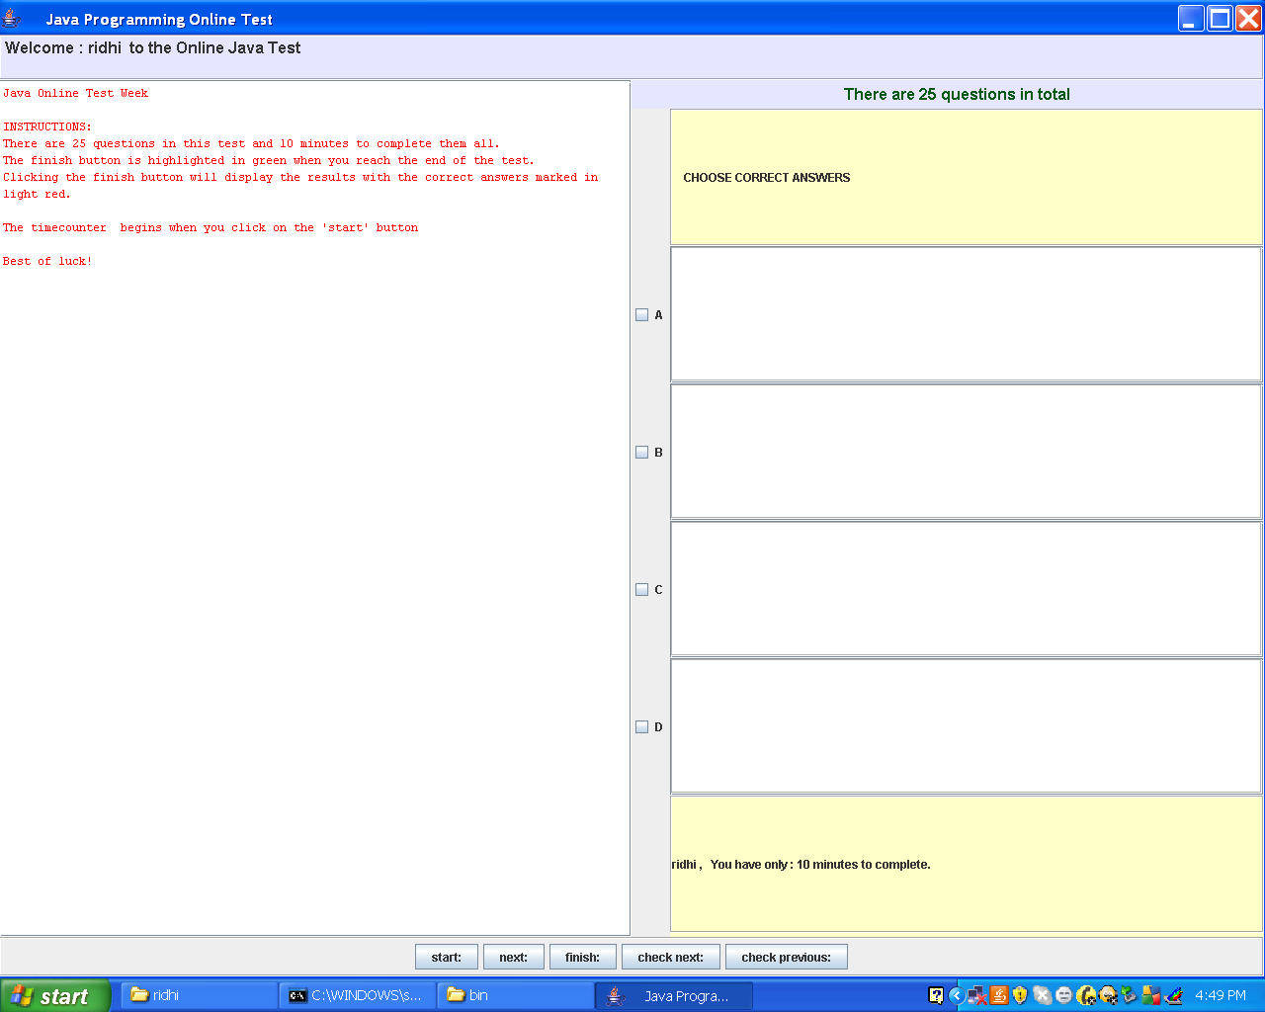
.

Slide 14
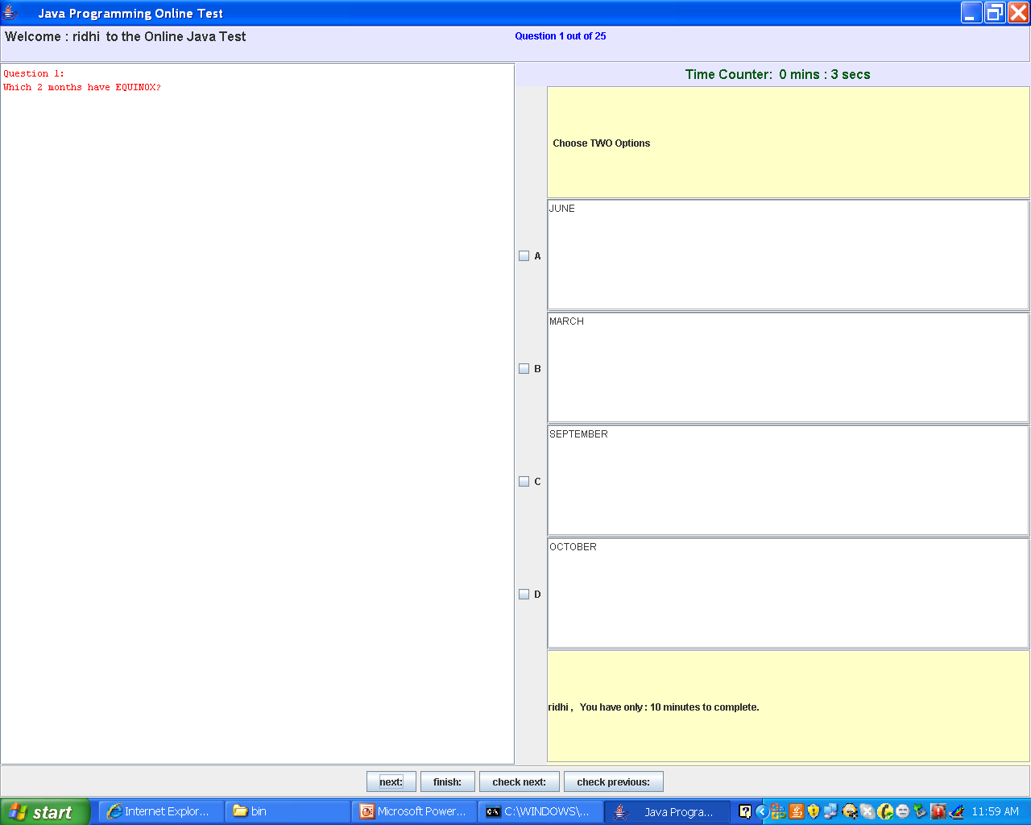

Slide 15
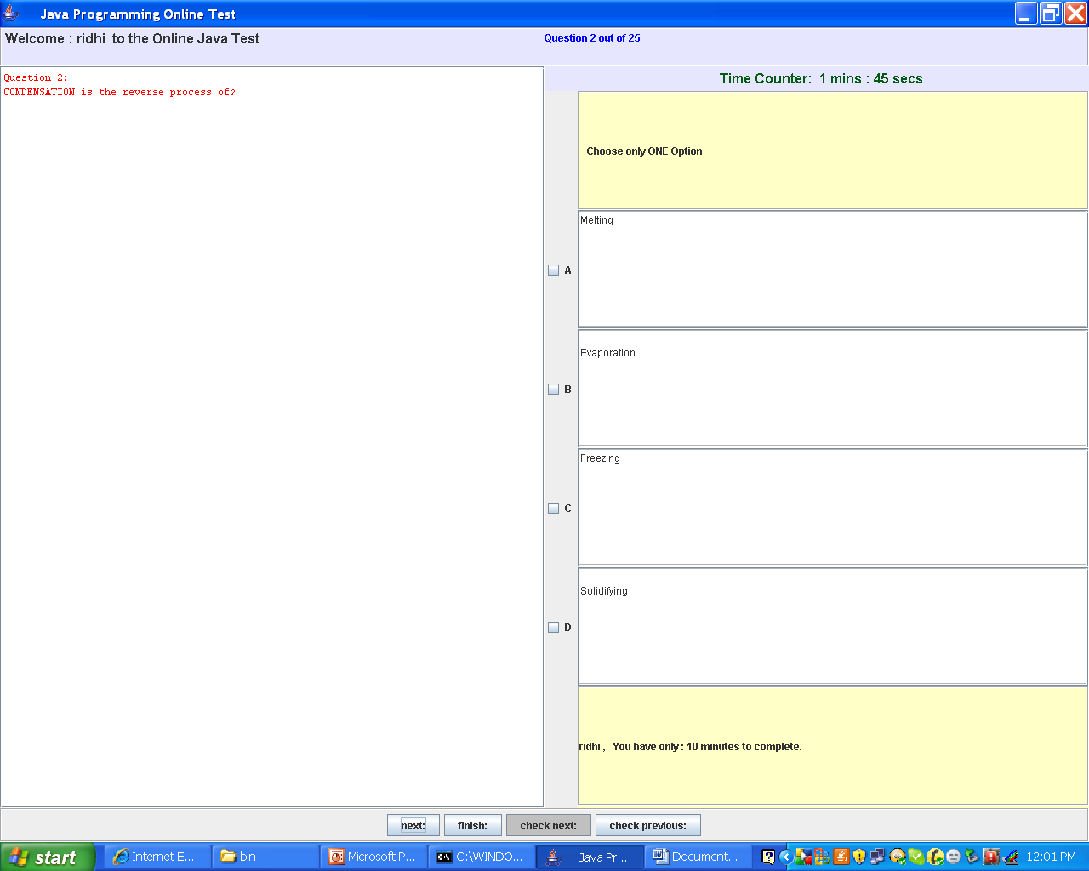

Slide 16
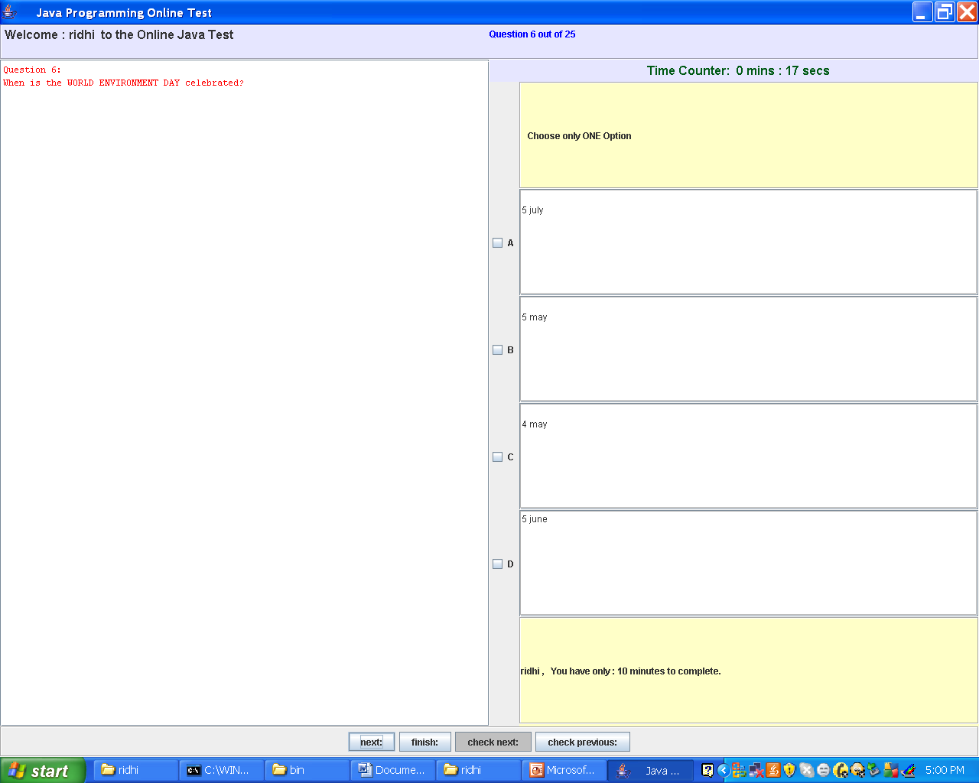

Slide 17
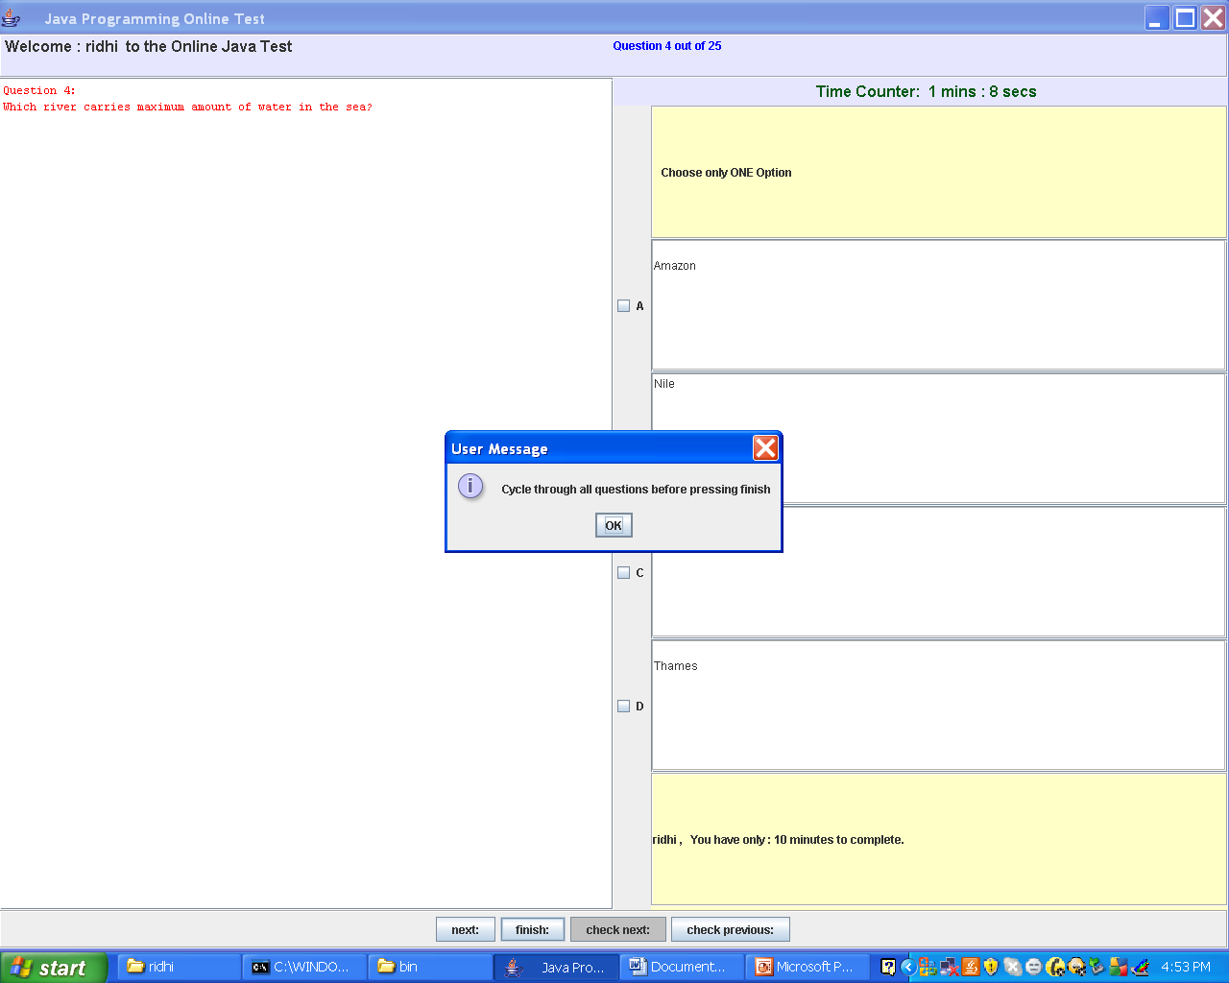

Slide 18
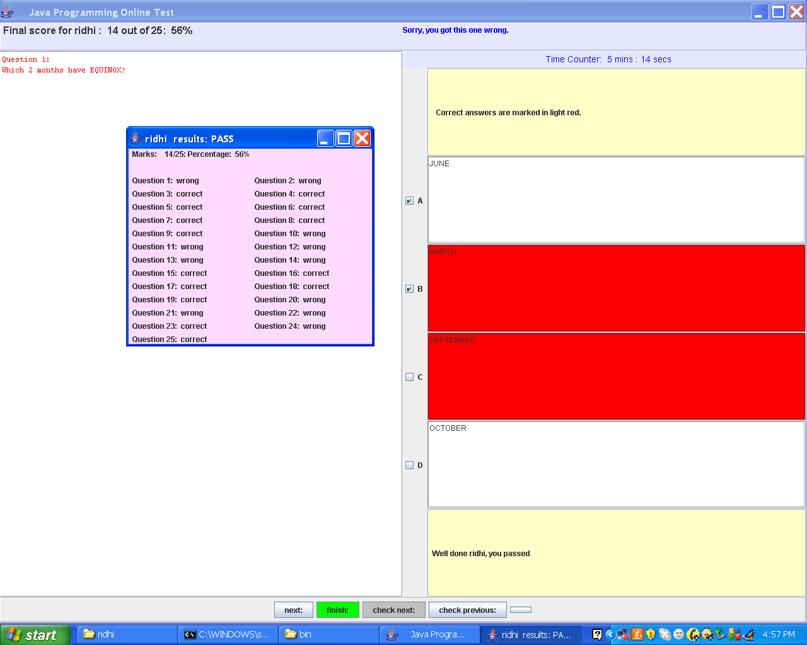

Slide 19
AREAS OF APPLICATION
Across the globe: This project finds it application in conducting examination over the globe.
Student’s needs: It saves time as well as money. It lessens student’s frustration

Slide 20
Economic Feasibility
It provides an efficient and reliable platform to work upon.
It saves time and is thus a faster means of examination.
It is less costly than the other means of examination

Slide 21
Advantages of the Software
Since this software is designed in java, it is Platform independent..
Successfully handles the problem.
Reliability gives consistent results.
System is robust.

Slide 22
Limitations of the Software
All the questions have to be scrolled once before clicking the finish button
A user must have fundamental knowledge as to how to use the application

Slide 23
FUTURE SCOPE
Every type of exam can be conducted online and it will lessen the teacher’s frustration.
We can also conduct tests for various subjects.
Tests can also be conducted for various difficulty levels.
We can provide limited access by giving passwords for users.

Slide 24
CONCLUSION
Conducting online test is a step to ease the current structure of examination. This way of conducting test on one of the most secure operating system and with highly sophisticated technology is cost effective and save time too.
This way of conducting test not only save time but also lessens student’s and teacher’s frustration. It is an easier way of giving examination, any person across the globe can appear for the examination.

Slide 25
The project entitled “ONLINE TEST” has been successfully compiled and made to run using the following main components of core Java:
EVENT HANDLING
EXCEPTION HANDLING
LAYOUTS
SWINGS

Slide 26


